Slide 1
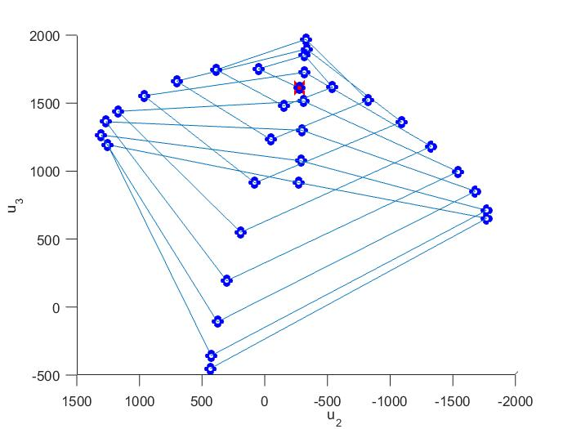
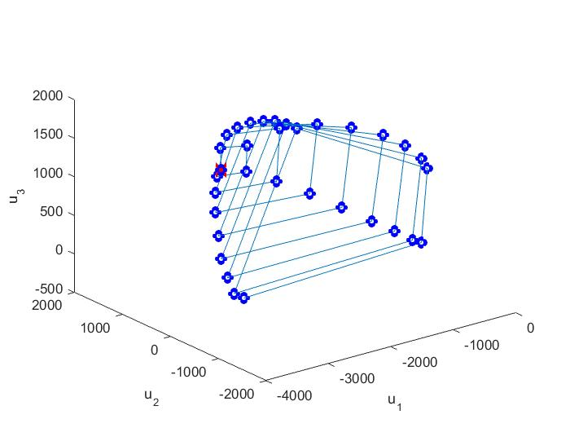
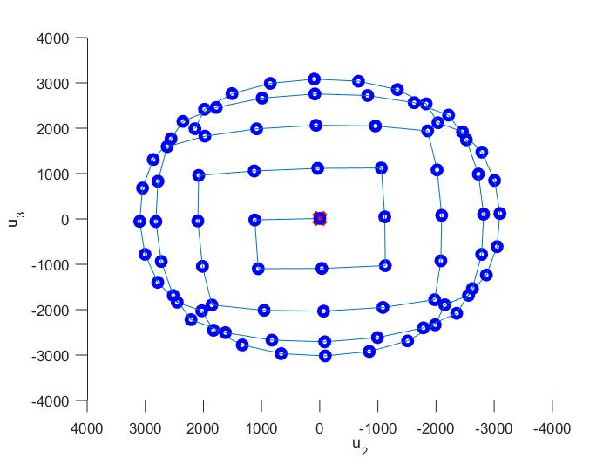
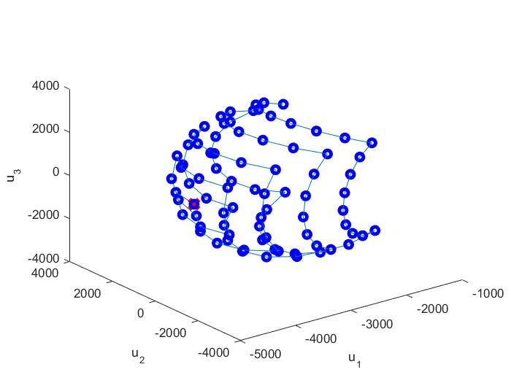
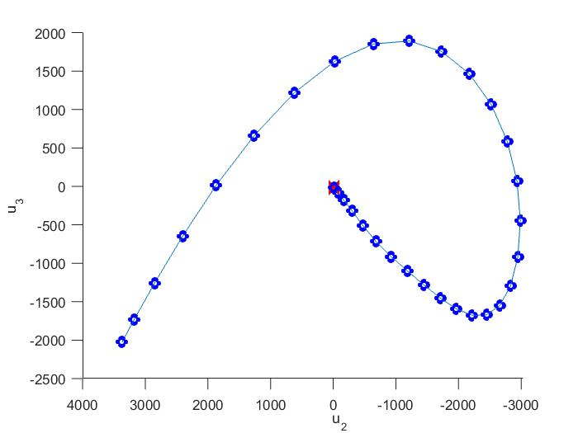
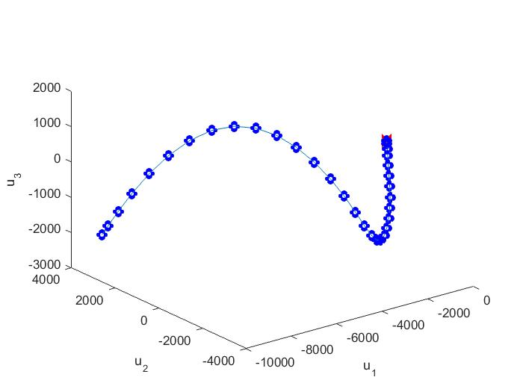
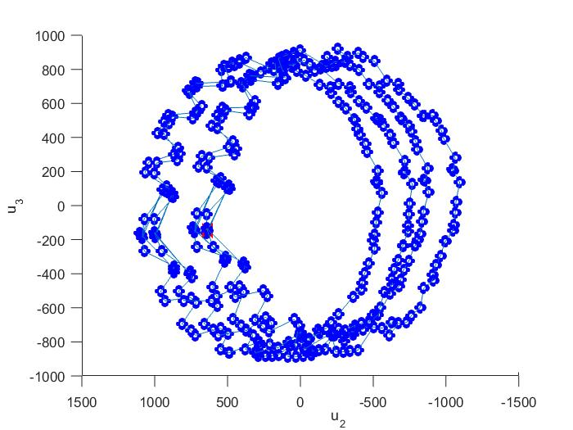
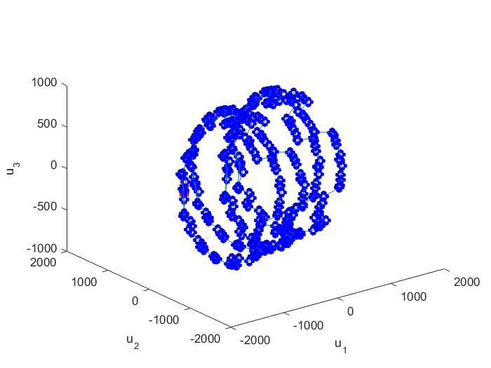
An Investigation into Manifold Learning Techniques and Biometric Face Registration for User Authentication Brandon Barker, Boise State University Faculty Advisor: Randy Hoover, Ph.D
Introduction
Results
Results (cont.)
From law enforcement to private corporations, facial recognition technology is becoming more commonly used. Unfortunately, correctly identifying a face in imperfect conditions using this technology continues to prove challenging. This work investigates manifold learning techniques applied to facial image variation across scale, registration, planar rotation, and projective skew. The goals of the research are to gain useful insight into the manifold structure both geometrically and heuristically. Several manifold examples are presented using a projection from high-dimensional image space to a 3-dimensional subspace computed using principal components. It is shown that regardless of the individual under consideration, the manifold embedding for each variation remains geometrically and heuristically similar.
The following images are examples of each transformation applied individually.
Each pair of figures represents a single manifold shown from two different angles so that the overall 3-dimensional shape can be seen and understood.
For these manifolds, every blue dot represents a transformed image.
The manifold created from registration transformations based on a constant 2 pixel adjustment:
The manifold created from scalar transformations ranging from 2x2 to twice the original image size:
The manifold created from planar rotational transformations ranging from 0-359 degrees:
The manifold created from applying projective skew transformations in four different angles:
We continued to produce data to create these manifolds for 8 different individuals from the ORL face database.
We were able to determine that regardless of the individual under consideration, the manifold embedding for each variation remains geometrically and heuristically similar.
Registration
Scale
Rotation
Projective Skew
Objective
Our objective is to investigate the geometric structure of facial manifolds across different image registration transformations
Scale
Registration
Planar Rotation
Projective Skew
References
Methods
1. Nayar, S., Nene, S., & Murase, H. (1995). Subspace Methods for Robot Vision. IEEE Transactions on Robotics and Automation, 750-758.
2. Reel, P. S., Dooley, L. S., & Wong, P. (2012). Efficient image registration using fast principal component analysis. 2012 19th IEEE International Conference on Image Processing. doi:10.1109/icip.2012.6467196
3. Zitová, B., & Flusser, J. (2003). Image registration methods: A survey. Image and Vision Computing, 21(11), 977-1000. doi:10.1016/s0262-8856(03)00137-9
All images used in this work were taken from the ORL database
Represent greyscale images as a point in high dimensional image space
i.e., $x_{i}∈{[0,1]}^{hv×1}$
Apply each of the aforementioned transformations to each facial image in the database
Store each transformed image into a collection of images in a data matrix $X$
$X=[x_{1},x_{2},…,x_{n}]$
Apply the Singular Value Decomposition to the image data matrix
$svd\left(X\right)=USV^{T}$
Construct a 3-dimensional manifold for investigation of the geometric structure
$ℳ=U_{3}^{T}X$, where $U_{3}$ contains the first three columns of $U$
Repeat this process for multiple subjects and all four transformations
Acknowledgements
This research was made possible by the National Science Foundation REU Security Printing and Anti-Counterfeiting site EEC-1560421. Thanks to advisor Dr. Randy Hoover and REU site director Dr. Grant Crawford for their direction and guidance, Professor of English Dr. Alfred Boysen for his critique in writing and speaking, and a special thanks to all of the faculty and staff at SDSM&T.

